Slide 1
MAGNETIC PROPERTIES OF MATTER PHY 170 LECTURE 3 & 4 Abavare

Slide 2
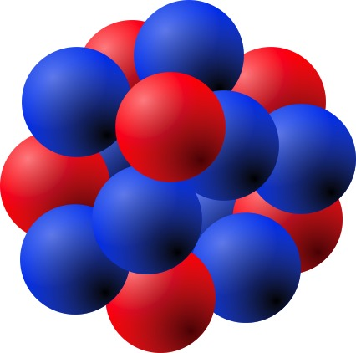
MACROSCOPIC MAGNETIC PROPERTIES OF MATTER
This is due to the following atomic properties:
An atom is made up of a number of charged particles in constant motion. Electrons orbit round the nucleus continually whilst within the nucleus protons and neutrons orbit round each other.
These orbital motions may be considered flowing electric currents which generate corresponding magnetic fields.

Slide 3
Origin of Magnetism in macroscopic materials
The electrons, protons and neutrons all spin about their axes which create flowing electric currents generating magnetic fields.
These magnetic fields can be described in terms of their corresponding magnetic dipole moments.
These small magnetic dipole moments can produce a strong magnetic field especially in the presence of an external magnetic field.

Slide 4
The strength of the magnetic field produced, however, depends on how readily the atomic and subatomic dipoles respond to the external magnetic field.
Depending on their magnetic response, materials may be put into the following categories:
Diamagnetic Materials
Paramagnetic Materials
Ferromagnetic Materials
Ferrimagnetic Materials

Slide 5
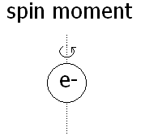
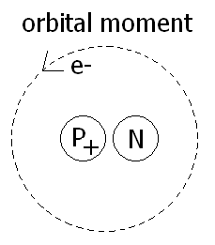
Origin of Magnetism macroscopic materials
Tiny spinning negative charge with an intrinsic spin angular momentum S
Associated with this spin angular momentum is intrinsic magnetic dipole moments
Magnitude of spin angular momentum, as predicted by quantum theory and as measured in the laboratory:

Slide 6
SI unit
Unit of spin angular momentum: The Bohr magneton denoted by:
Quantum theory predict that spin angular momentum is:

Slide 7
Origin of Magnetism macroscopic materials (cont’d)
B. The electrons that orbit around its nucleus makes a miniature current loop resulting in an orbital magnetic dipole moment
Given by:

Slide 8
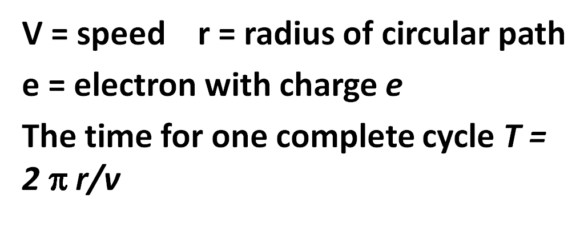
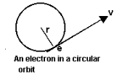
ATOMIC AND NUCLEAR MAGNETIC MOMENTS
An electron moving in an orbit around a nucleus produces an average current I along its orbit. For an electron in a circular path

Slide 9
The magnitude of L is always some integer multiple of the constant . Thus, the possible values of the orbital angular momentum L are
L = 0, , 2, 3, 4, ......... (2.4)
Because angular momentum exists only in discrete packets, it is said to be quantized.
The net magnetic moment of the atom is obtained by combining the orbital and spin moments of all the electrons, taking into account the directions of these moments.

Slide 10
NB
The nucleus of the atom also has a magnetic moment. This is due to
(i) the orbital motion of the protons inside the nucleus, and
(ii) the rotational motion of individual protons and neutrons.
The magnetic moment of a proton or neutron is small compared with that of an electron, and in reckoning the total magnetic moment of an atom, the nucleus can usually be neglected.

Slide 11
CLASSIFICATION OF MAGNETIC MATERIALS
Establish the relationship
Basic interactions:
Diagmagnetic, paramagnetic, ferromagnetic

Slide 13
DIAMAGNETISM
Diamagnetic materials
interact weakly with an imposed magnetic field.
weaken the existing magnetic field.
have negative values of magnetic susceptibility.
The magnetic susceptibility is independent of temperature and solenoid current.
A change in magnetic field lines threading a current loop causes a current to be induced in the loop. The magnetic flux produced by the induced current always acts to oppose the change.

Slide 14
Diamagnetism is a property of all materials, but it is a very weak property and is observed in materials made of atoms that have permanent magnetic dipole moments.
When a diamagnetic material is placed in a magnetic field B, the force experienced by the electron is -ev x B in addition to the usual electric force within the atom
Assume that the nucleus produces an electric field E. Then the net force on the electron is -eE - ev x B.
To keep the electron in a circular orbit of radius r,
eE + evB = m_{e}v²/r ………………….. (1) finish the prove

Slide 15
PARAMAGNETISM
Paramagnetic materials
interact weakly with the imposed magnetic field
strengthen the existing magnetic field
have positive values of
depends on temperature and is essentially independent of solenoid current
A paramagnetic material is composed of a uniform distribution of atomic magnetic dipoles sufficiently separated so that the magnetic field of any given dipole does not influence any of its neighbours.

Slide 16
In the absence of magnetic field, the dipoles are randomly oriented as a result of thermal motions.
The net magnetic moment of a paramagnetic material is, therefore, zero.
However, when an external magnetic field is applied, the dipoles align themselves with the field and produce a net magnetic moment in the material.
Magnetic alignment can be achieved in two ways: (i) by lowering the temperature of the specimen or (ii) by increasing the applied magnetic field.

Slide 17
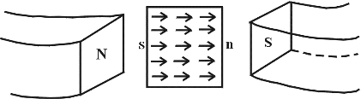
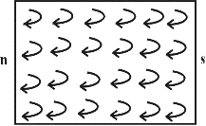
How does such an increase of magnetic field come about?
Fig. 2.1: A piece of paramagnetic material in an electromagnet.
Fig. 2.2: Alignment of current loops.

Slide 18
Figure 2.1 shows the alignment of the magnetic
dipole in such a material
Figure 2.2 shows the alignment of current loops.
Consider a piece of paramagnetic material placed between the poles of an electromagnet.
The magnetic dipoles are due to small current loops within the atoms.
Now look at any point inside the material where two of these current loops (almost) touch. The currents at this point are opposite and cancel. Thus, everywhere inside the material, the current is effectively zero.

Slide 19
However, at the surface of the material, the current does not cancel. The net result of the alignment current loops is therefore a current running along the surface of the magnetized material.
The material consequently behaves like a solenoid; it produces an extra magnetic field in its interior.
This extra magnetic field has the same direction as the original, external magnetic field. Hence, the total magnetic field in a paramagnetic material is larger than the original magnetic field produced by the currents of the electromagnet.

Slide 20
Magnetization
Pierre Currie discovered experimentally that the magnetization M of a paramagnetic specimen is directly proportional to B, the effective magnetic field in which the specimen is placed, and inversely proportional to the kelvin temperature T. In equation of the form
(Curie’s law)

Slide 21
NB:
The alignment of atomic dipole moment in a paramagnetic specimen enhances the magnetic dipole moment,
and the magnetic field increases.
It follows that is positive.
EXAMPLES
Tungsten, Cesium, Aluminium, Lithium, Magnesium, Sodium

Slide 22
FERROMAGNETISM
Ferromagnetic materials
interact strongly with an imposed magnetic field
strengthen the existing magnetic field
have magnetic susceptibilities that depend sensitively on the solenoid current.
Ferromagnetism is exhibited by five elements - iron (Fe), nickel (Ni), cobalt (Co), dysprosium (Dy), and gadolinium (Gd) - and some alloys, which usually contain one or more of these five elements.

Slide 23
The intense magnetization in ferromagnetic materials is due to a strong alignment of the spin magnetic moments of electrons.
In these materials, there exists a special force that couples the spins of the electrons in adjacent atoms in the crystal.
This force (known as exchange coupling) couples magnetic moments of adjacent atoms together in rigid parallelism.
There are regions in every ferromagnetic specimen that have near perfect alignment of magnetic dipole moments even when there is no applied magnetic field.

Slide 24
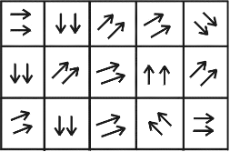
These regions are called magnetic domains.
The direction of alignment of the dipoles varies from one domain to the next (Fig. 2.3).
Fig. 2.3: Magnetic domains in a ferromagnetic material.
However, if the material is immersed in an external magnetic field, all dipoles tend to align along this field. The domains then change in two ways:

Slide 25
Those domains with magnetic dipole moments parallel to the magnetic field grow at the expense of the neighboring domains (Fig. 2.3). This effect is responsible for producing a net magnetic dipole moment in a weak applied magnetic field.
The magnetic dipole moments of the domains rotate toward alignment with the applied magnetic field. This is the mechanism of magnetic dipole alignment when the applied magnetic field is strong

Slide 26
Hysteresis loop
Magnetized ferromagnet in one direction, will not relax back to zero magnetization when the imposed magnetizing field is removed
It must be driven back to zero by a field in the opposite direction.
The lack of retraceability of the magnetization curve is the property called hysteresis and it is related to the existence of magnetic domains in the material

Slide 27
Hysteresis loop
Fig. 2.4: The magnetization ‘M’ vrs magnetic field strength ‘H’ for a ferromagnetic:
Area enclosed by the curve determines the strength of the magnetic

Slide 28
NB:
If the direction of the current in the solenoid is reversed, the magnetic field (B) within the specimen is reduced steadily from the remanent value B_{r}
At a critical value of B_{E}, called the coercive force (B_{c}), the magnetic field is zero.
The larger the coercive force, the more difficult it is to demagnetize a ferromagnetic specimen.
Ferromagnetic materials having a large coercive force are said to be magnetically “hard”, those having a small coercive force are said to be magnetically “soft”.

Slide 29
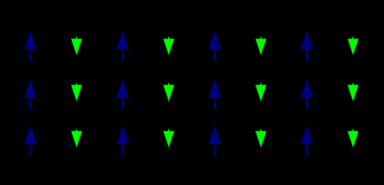
FERRIMAGNETISM
Magnetic moments of the atoms on different sublattices are opposed, as in anti-ferromagnetism
opposing moments are unequal and a spontaneous magnetization remains.
sublattices consist of different materials or ions (such as Fe2+ and Fe3+).

Slide 30
The oldest-known magnetic substance, magnetite (iron(II,III) oxide; Fe₃O₄)
Some ferrimagnetic materials are YIG (yttrium iron garnet)
ferrites composed of iron oxides and other elements such as aluminum, cobalt, nickel, manganese and zinc.

Slide 31
FERRIMAGNETISM
Ferrimagnetism is exhibited by ferrites and magnetic garnets
Materials hold a spontaneous magnetization below the Curie temperature
Show no magnetic order (are paramagnetic) above this temperature
Have high resistivity and anisotropic properties

Slide 32
The story goes that a Greek shepherd named Magnes was wandering through part of Asia Minor then known as Magnesia (Presnt Turkey).
What Was So Mysterious About Them?
Magnes found that the tip of his shepherd’s crook, which was iron, was attracted to these rocks by an unseen force. It was as if invisible hands caused the metal tip to be drawn in. Experimenting with the stones he found that they attracted lots of metal things, but not other things, like straw or grass. What had Magnes found? You guessed it. Magnetite!
These days magnetite is also known as lodestone. It’s not actually a stone, though. It’s a kind of iron ore. And it has naturally magnetic properties! We usually think of magnets as being human-made. In fact you can make your own magnet, and probably every magnet you’ve ever seen was human-made. But magnets also occur in nature.
Even though Magnes the shepherd may be a myth, this is where magnets got their name, and the mysterious black stones of Magnesia are quite real. They are naturally occurring magnets known as magnetite.

Slide 33
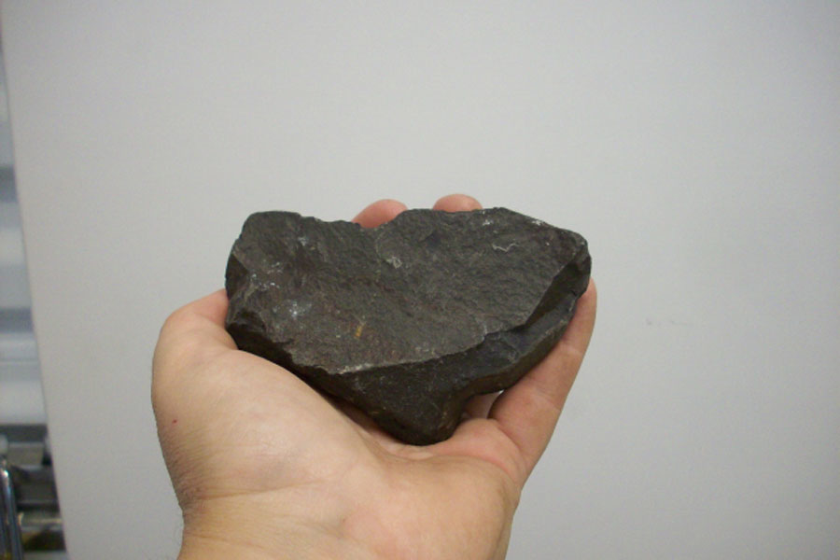
The Sheppard stone (magnetite or Lodeston)

Slide 34
Effects of temperature
Hold spontaneous magnetization below the curier temperature and show no magnetic order above this temperature
When sublattices have equal magnetic moments, net magnetic moment is zero (magnetization compensation point)
Also hold angular momentum compensation point when the angular momentum of the magnetic sublattices are compensated
Compensation point crucial for achieving high speed magnetization reversal in magnetic memory

Slide 35
Properties
Ferrimagnetic materials have high resistivity and have anisotropic properties
Extenal magnetic field induced anisotropy
When this applied field aligns with the magnetic dipoles it causes a net magnetic dipoles to precess at a frequency controlled by the applied field, called Larmor or precession frequency

Slide 36

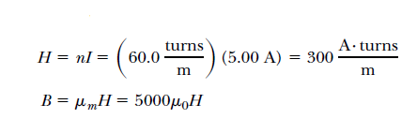
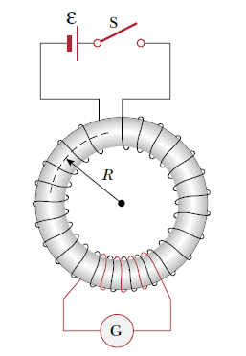

Question :
Solution:

Slide 37
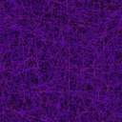
Question :
Given μ=1.8x10E-5 H/m and H=120 A/m for a magnetic material,
calculate M(Magnetization).
Solution:

Slide 38
Question :
Given B = 300 μ T and ᵡ_{m}=15 for a magnetic material,
calculate M (Magnetization).
Solution:

Slide 39
Summary
Magnetization results from miniature bound current loops of electrons with
Orbital magnetic moments
Spin magnetic moments
Materials respond differently to magnetic fields due to their varying degree of Magnetization .

Slide 40
Summary
Different classes of materials exist, some have weaker and some stronger magnetic effects.
The permeability constant indicates the magnetization and magnetic effects of material.
Applications of magnetic materials include: permanent magnets, data storage, motors, generators, transformer/toroid cores, etc.

Slide 41
End of lecture
You must be tired right?

